Slide 1
Defects KPI
Apoorva Kalaskar Batch: DP-2008-OM

Slide 2

Problem Statement
All the industries have need of Defect KPI for various needs as below:
To improvise process functioning
Timely reporting of defects to concerned people
Resolving the defects in designated timeframe
To handle all these pointers there is a need to have Defect KPI which can give us a visualization of all related details.

Slide 3
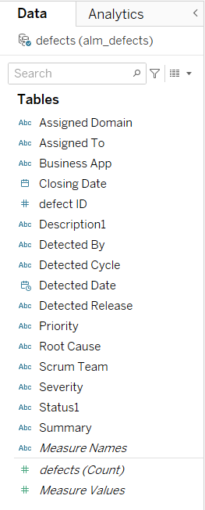
Dataset
The data is real data collected from SLB organization.
It has 16 attributes describing the defect in detail.
Created schema in SQL and loaded the excel file to SQL Database.
Connected Tableau to SQL and connected to Defects database.
Performed some initial analysis on data like: checking for null values, correcting the date format, removing the columns which are not needed.

Slide 4
Objectives:
The main aim to have dashboard is to see ‘Open’ defects, status of the defect, priority of defect and the domain to which it is assigned.
We also need overview of all defects related to particular release and then need to see all important features related to defects.
Common Filters:
Business Application
Release Cycle
Worksheets:
Count of Defects by Release Cycle
Count of Defects belonging to specific Priority by Release Cycle
Count of Defects having specific Status by Release Cycle
Count of Defects related to Domains by Release Cycle

Slide 5
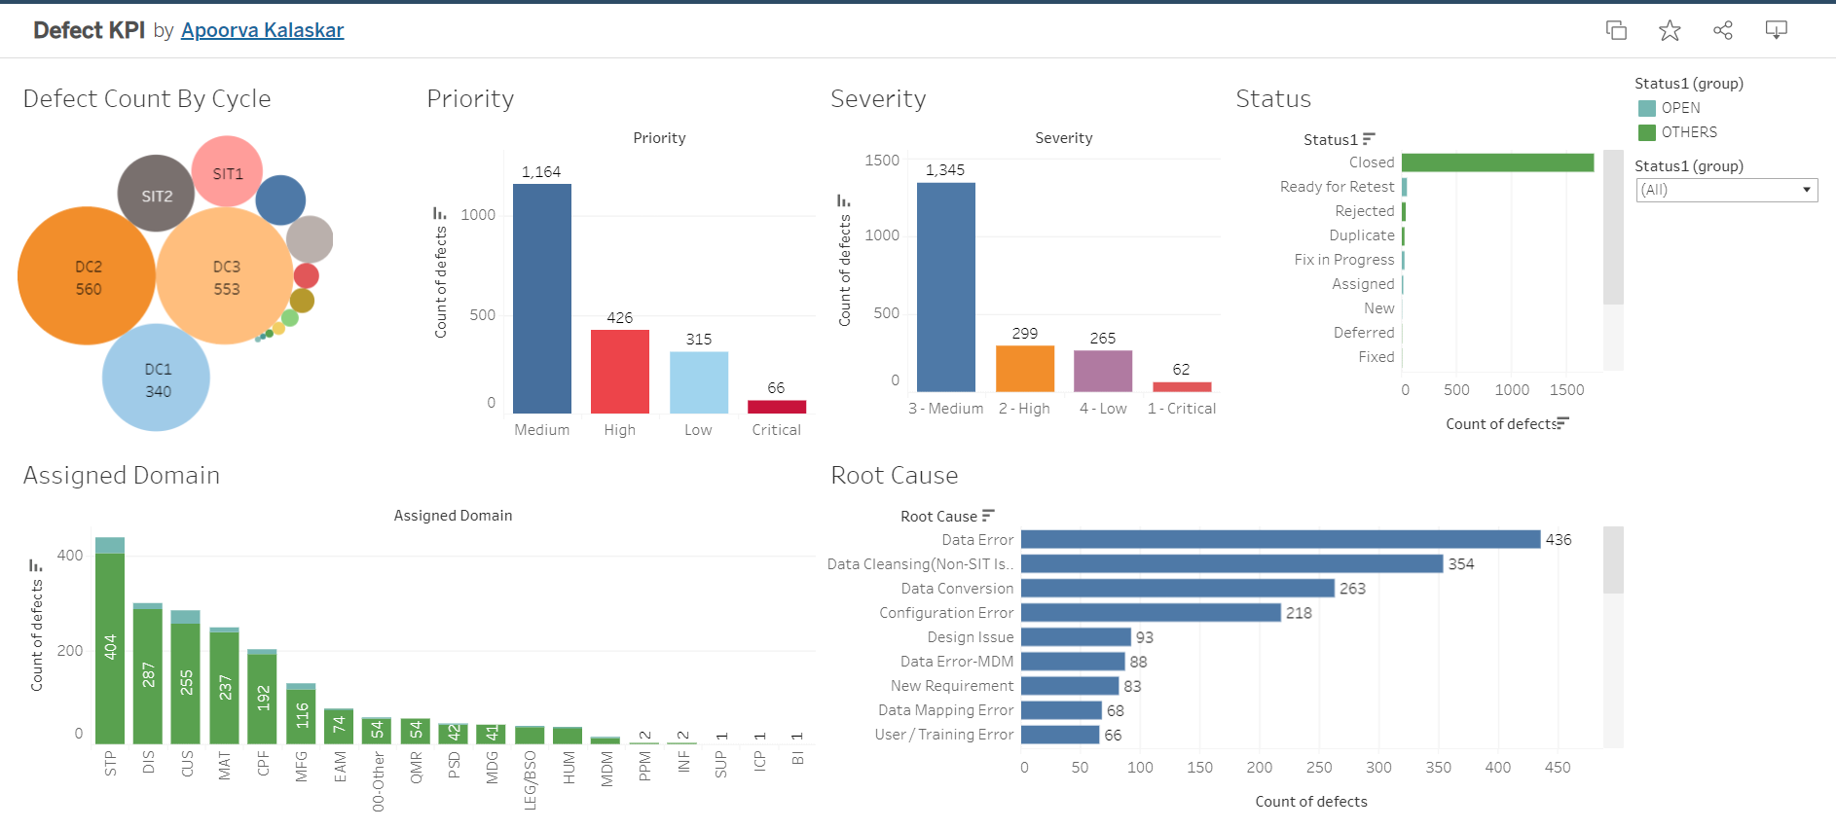
Dashboard
Defect KPI | Tableau Public

Slide 6
THANK YOU!!

